Slide 1
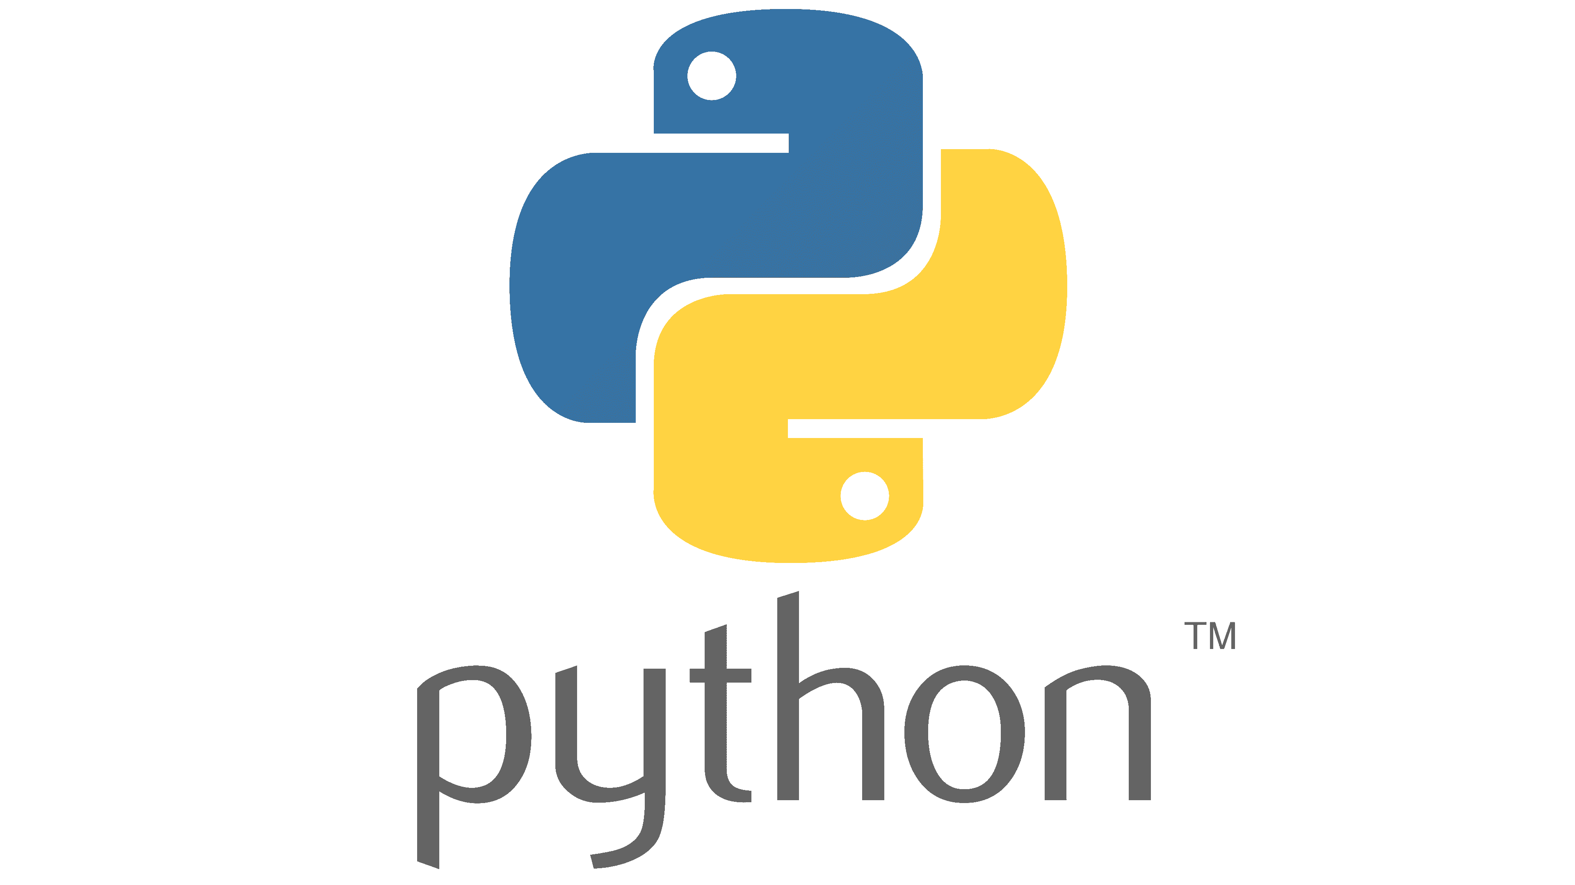
Back End Technologies
1. Python
Python is a leading all-purpose programming language created by a Dutch programmer Guido van Rossum in 1991. With core competency of concise and readable codes, Python supports backend programmers to write rational and explicit scripts.
According to the 2020 Developer Survey of Stack Overflow, it is the most wanted back-end technology that developers want to learn. It maintains the third position among the most loved programming technologies as well.

Slide 2
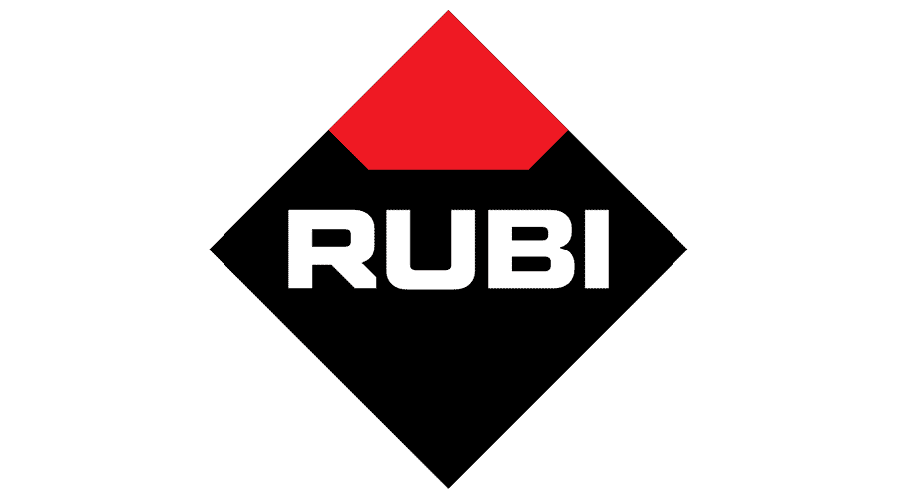
2. Ruby
Ruby is another open-source backend technology that was designed by Japanese computer scientist Yukihiro Matsumoto in the 1990s. This scripting language has similarities with Python, Java, and Perl.
Ruby is usually used for the development of web applications and is considered the favorite for prototyping.
Tech businesses like Esty, Airbnb, and Shopify are using Ruby as backend scripting technology due to its object-oriented, scalability, and flexible programming features.

Slide 3
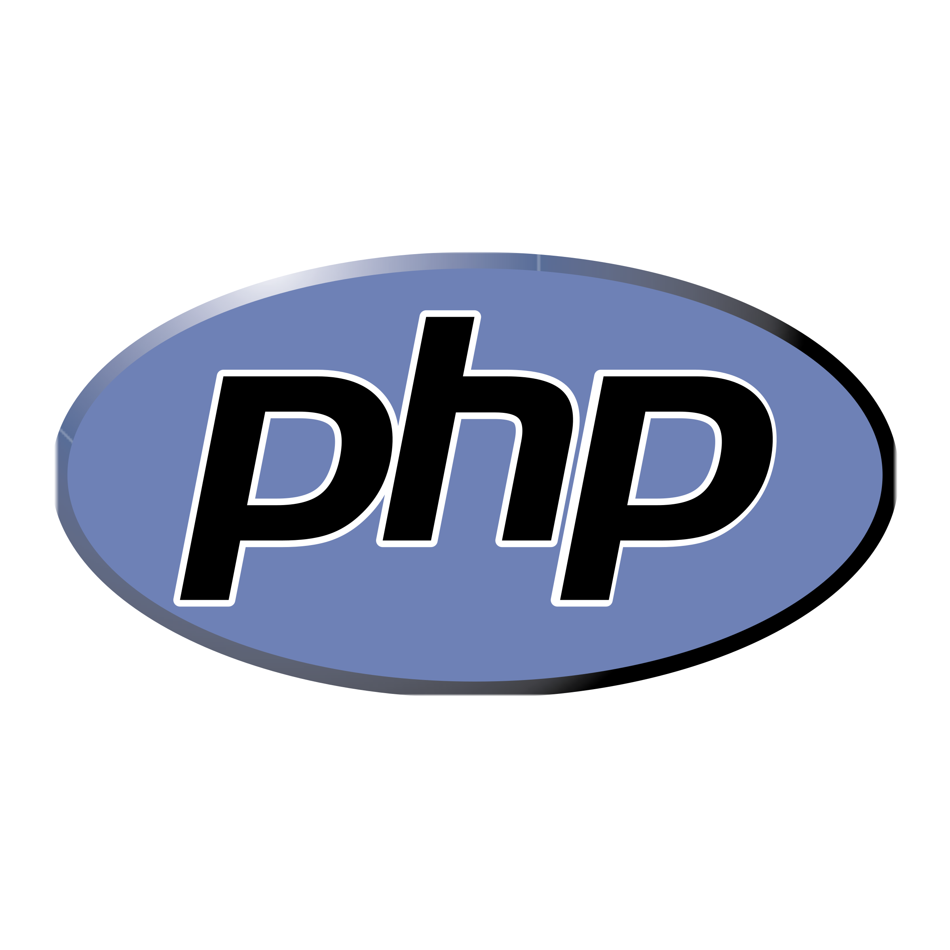
3. PHP
PHP is a leading server-side scripting technology that was introduced by Rasmus Lerdorf in 1994. This open-source backend technology is commonly used for websites. Around 79.1% of websites on the internet use PHP as server-side technology, according to a recent survey of W3Techs.
This general-purpose scripting language is easy to use and emend information in the databases. The availability of several modern frameworks, massive community, robust codebase, and easy deployment also adds tremendous value to this technology.
PHP developers argue it is better to use PHP with MySQL and Linux Apache for a smooth development process.

Slide 4
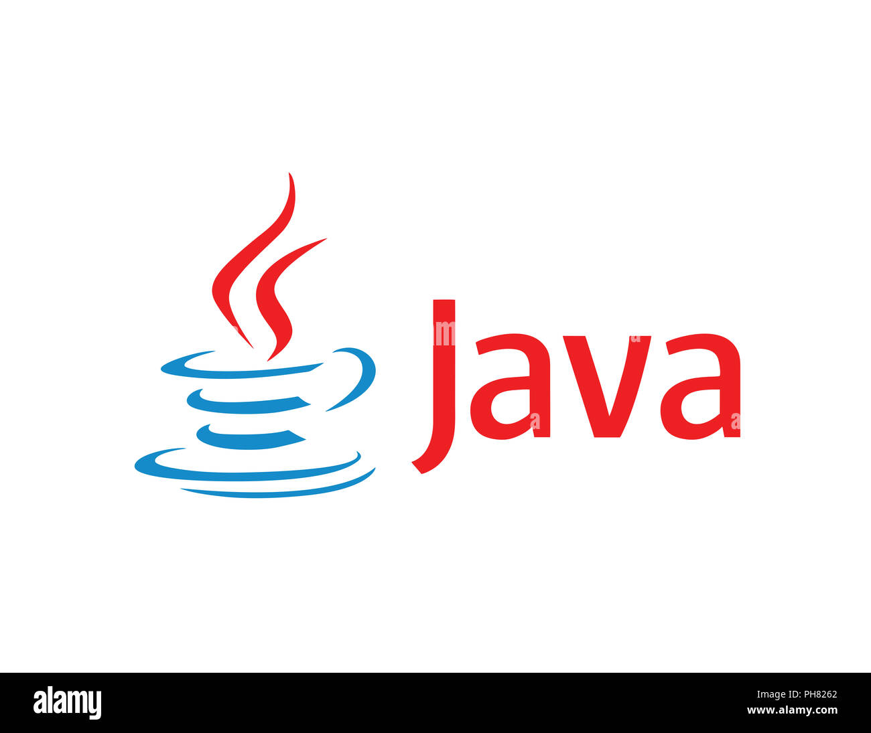
4. Java
Java is one of the most powerful backend technologies, which has the second rank, according to TIOBE Index. James Gosling originally developed this programming technology in 1991, but it was published in 1995 by Sun Microsystems.
Developers prefer to make feature-rich and adaptable web applications with Java for years. Howbeit, you can use Java for mobile devices, severe, and microcontroller software development as well.

Slide 5
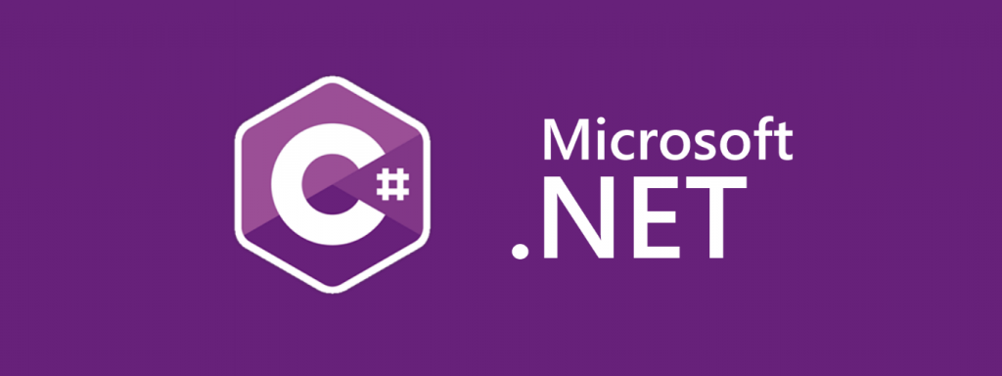
5. C# .NET
C# known as C-sharp is one of the most famous backend programming languages preferred for automation in the Windows environment. C# is also used for web development in the ASP.net framework. It is one of the oldest programming languages and an extension to C++.
This backend technology is most commonly used for desktop applications and embedded systems in this era. The execution speed of C# is faster than most of the other programming languages, i.e., Python.
In the modern world, C# is most widely used in game development using Unity like platforms. Backend engineers also use this backend technology to develop console applications.

Slide 6
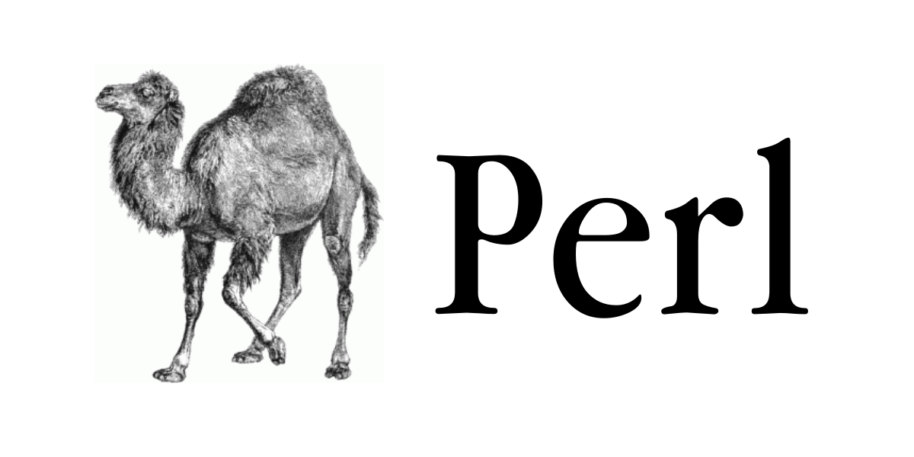
6. Perl
Perl is another general-purpose backend technology that Larry Wall developed 32 years ago. According to the Stack Overflow Developer Survey, Perl is the topmost paying technology globally.
By the way, it is significant to know that the same survey also ranks Perl among the first three dreaded languages.
Whereas Perl is pretty old-fashioned, but developers are still using Perl 5 for quick automation and prototyping.

Slide 7
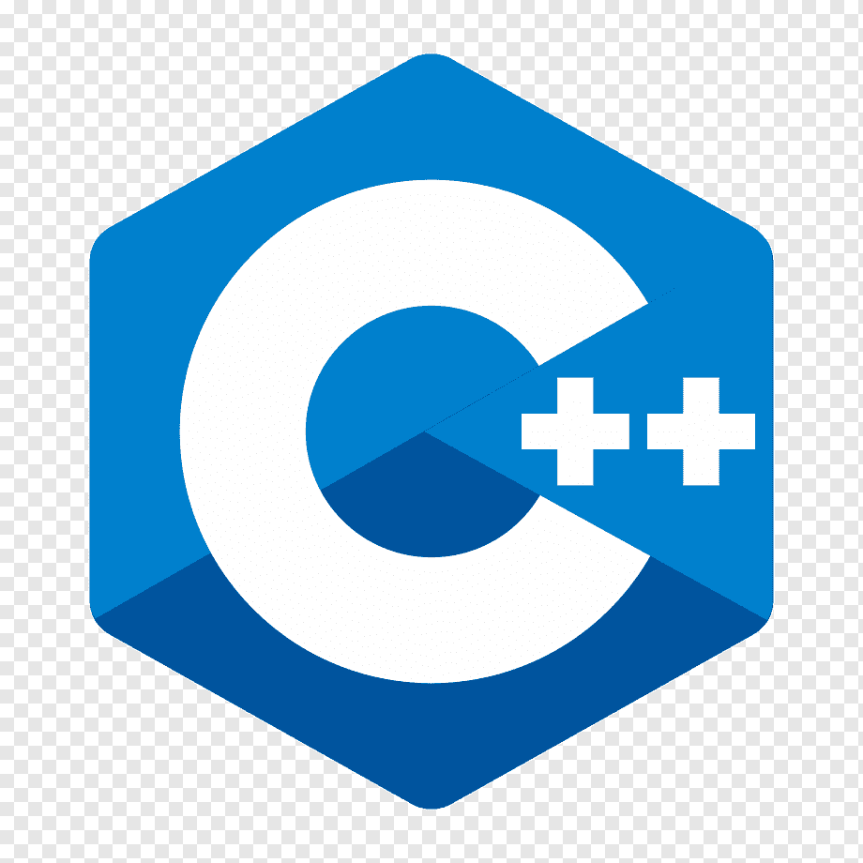
7. C++
C++ is an extended version of C language. C++ was introduced with classes. This concept of classes or object-oriented programming was missing in C language.
The idea of object-oriented programming is vital for any programming language in the modern world to write structured code using classes and by defining their relationships.
C++ is one of the oldest programming languages and is mostly used in system programming & embedded systems. C++ is a low-level language, and it can interact with the hardware resources. It is used for gaming applications, operating systems, database software, etc.

Slide 8
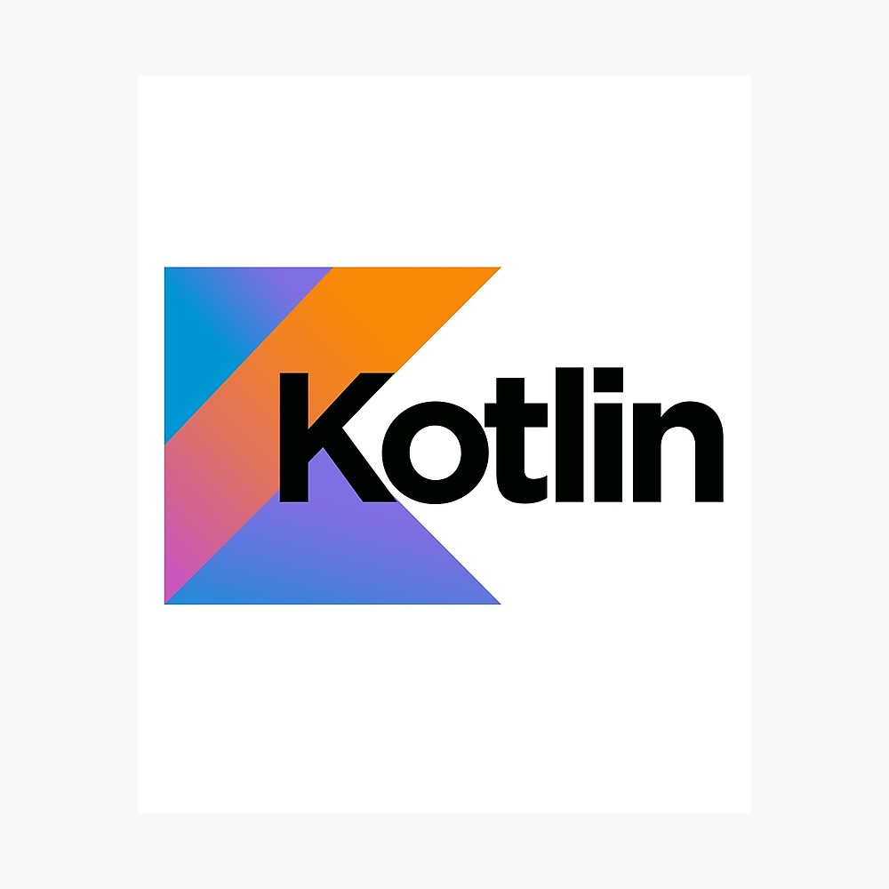
8. Kotlin
Kotlin is a backend programming language that is being used for the development of android applications.
It is taking over Java for the development of android applications, and its demand is increasing day-by-day. Over 60% of android app developers are using Kotlin at the backend. Kotlin interoperates completely with Java & JVM.
JetBrains introduced Kotlin as a backend programming language for Android applications in 2011. Since then, it has become one of the most famous programming languages in the world of computer science.

Slide 9
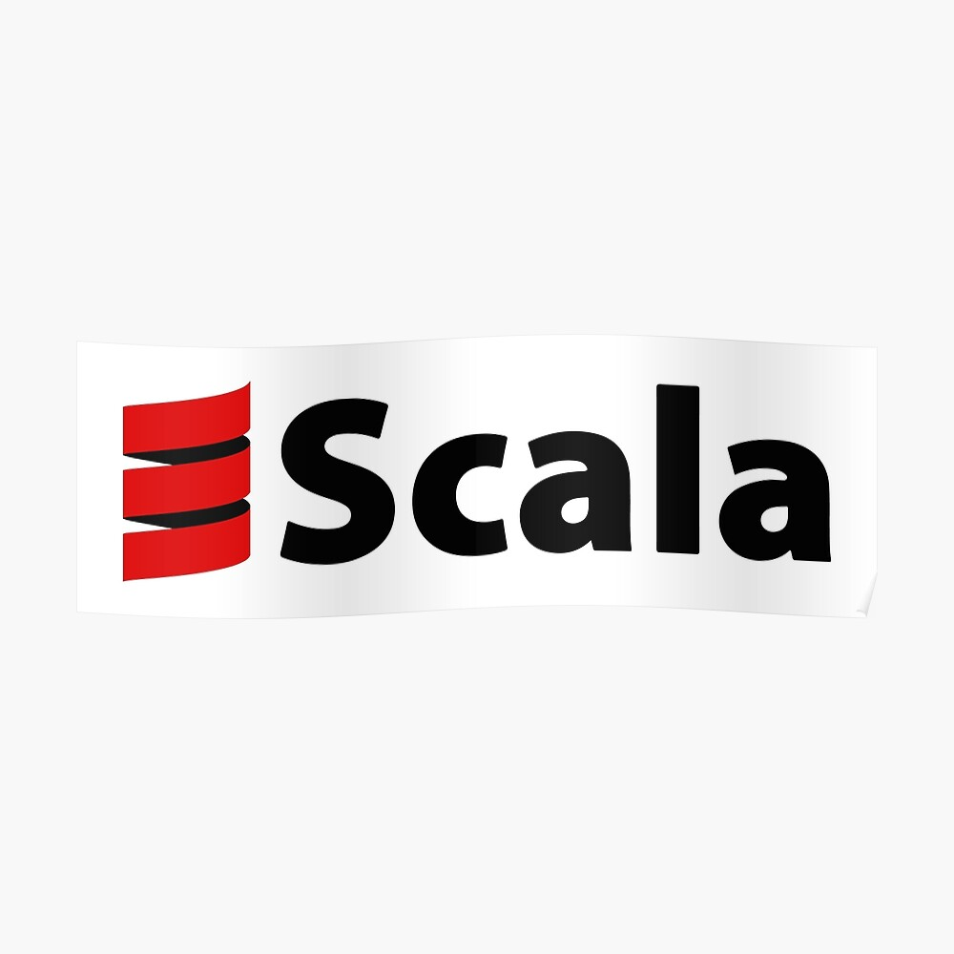
9. Scala
Scala is a high-level language that combines object-oriented & functional programming to make it more concise.
You can build high-performance systems accessing vast libraries of its JVM & JavaScript runtimes. Scala is interoperable with Java because it runs on JVM and can mix both languages’ code to give an ultimate solution.
The Scala compiler is helpful for static types. You do not need to work for types as the system will work for you about static types. It makes this backend programming language more helpful & useful.

